Slide 1
EVM & VVPAT An overview

Slide 2
AGENDA
History
Doubts Cast- Glance
Technical Security
Administrative safeguards
VVPAT
Doubts Cast- Explained
Aspersions Vs. Allegations
Technical Expert Committee (TEC)
International Experience
Past Judgements
Notes:
Hon’ble Chairman and respected members, over last 2 months several aspersions have been cast on the credibility of EVMs by certain political parties. Today it is my privilege to give a detailed briefing to the Hon’ble committee through this presentation on the journey of EVM covering legel technical and administrative aspects

Slide 3
HISTORY OF EVM
40 CREDIBLE YEARS

Slide 4
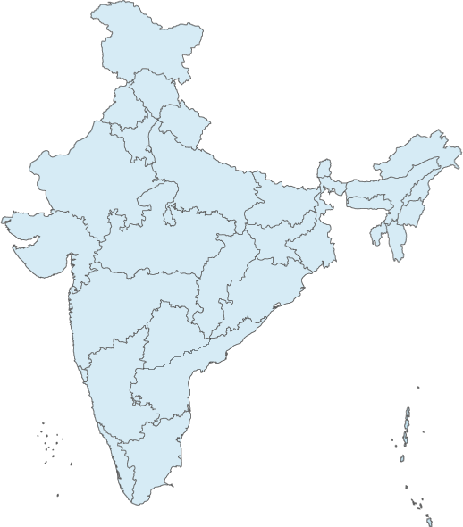
HISTORY OF EVM – 40 CREDIBLE YEARS
1977
CEC- S L Shakdar talked about introducing an Electronic machine
1980-81
EVMs developed and demonstrated by ECIL and BEL.
EVMs used in 50 polling stations of Parur LA in Kerala. Used in 11 Assembly Constituencies:8 states, 1UT
1982-83
1984
Usage of EVMs suspended: SC ruling-EVMs had no legal sanctity
1988
RP Act amended: allowing the use EVMs w.e.f. 15.03.1989
Since 2000, EVMs have been used in all elections. 3 Lok Sabha and 113 State Legislative Assemblies.
Notes:
EVM system has evolved over 40 years and have been in use in all elections since 2000

Slide 5
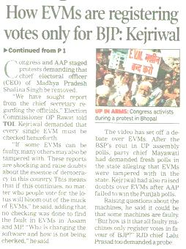
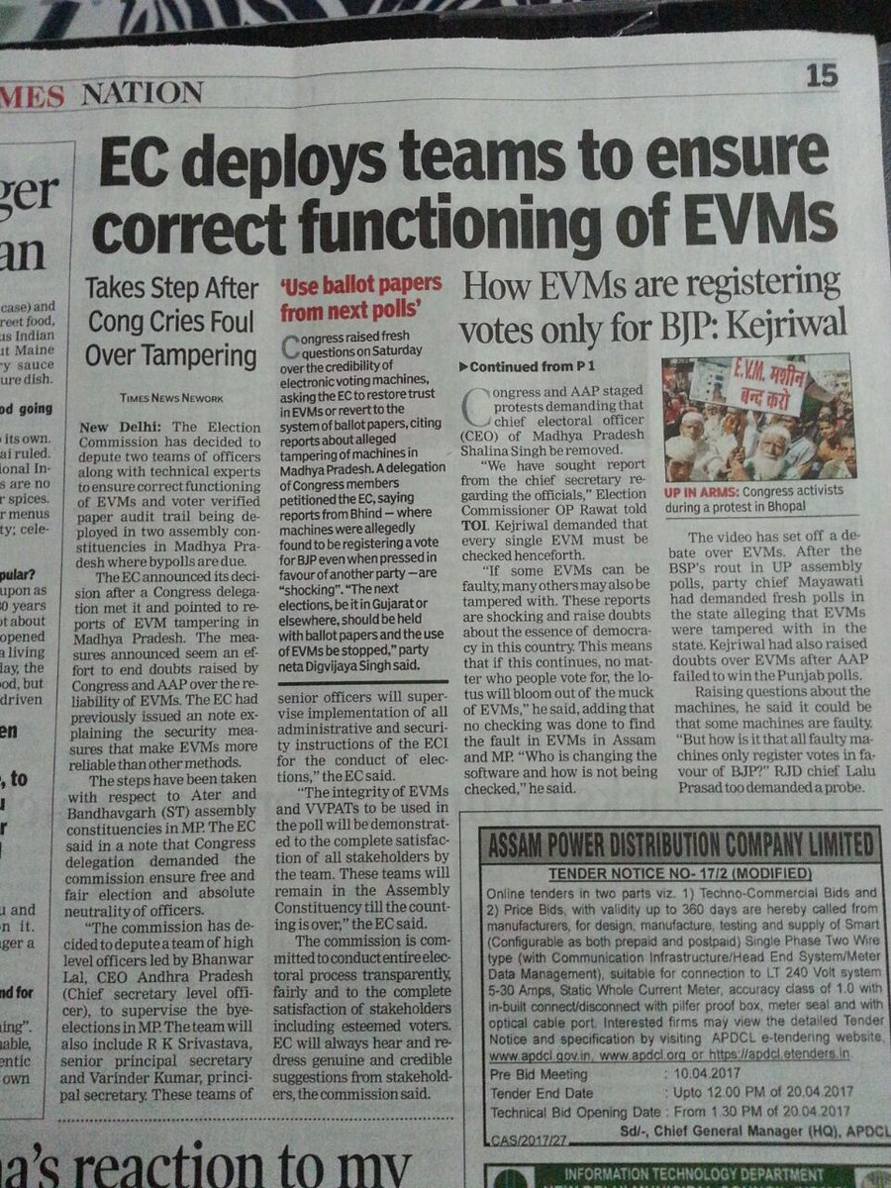
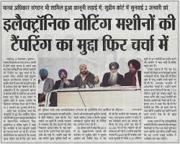
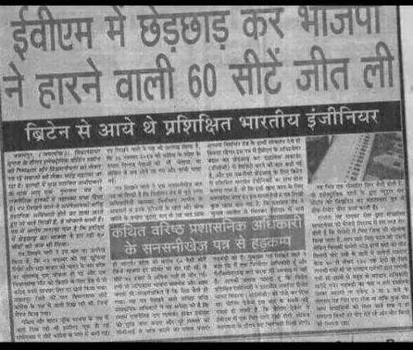
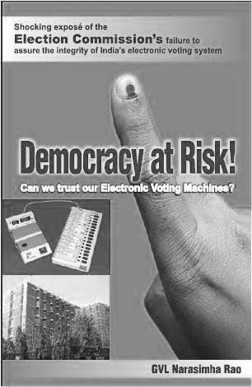
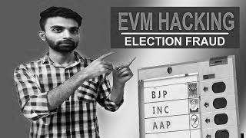
DOUBTS CAST ON EVM
Hacked EVM
Altered software code
Remotely Altered Control Unit Display
Replaced Microcontroller or Memory chips
Vote Stuffing after Poll Closure
Memory Manipulation
Notes:
A quick glance on the various doubts that have been raised – EVMs can be hacked, Result displayed on CU can be altered through wifi, Stored Data can be altered, microcontroller or memory or even full motherboard can be replaced, Trojan can be inserted into the software, Stuffing can be done after poll closure. Doubts also on why we continue to use EVMs when most foreign countries have discontinued using.

Slide 6
TECHNICAL EXPERT COMMITTEE
INDEPENDENT EVALUATION
Notes:
Next six slides to be made concise

Slide 7
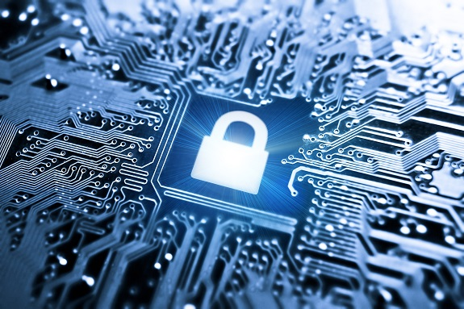
T E C- HISTORY & ROLE
TEC constituted for evaluation of upgraded EVMs Submitted an Evaluation Report in 2006
1st Technical Expert Committee (TEC) formed
January, 1990
December 2005
April 1990
November 2010
Recommended use of the EVMs unanimously
Latest
reconstitution
Notes:
Commission is aided by a Technical Expert Committee comprising of 4 eminent Professors from IITs, each of whom are renowned specialists in their fields. Prof Shahani present here heads the TEC and is one of the finest electronics expert. Prof Moona also present here is currently Director of IIT Bhilai and was till recently heading CDAC which has given India the supercomputer PARAM.

Slide 8
ROLE OF TEC
Give technical advice to build specifications and design of newer versions of EVMs/VVPATs
Examine design proposals of manufacturers on EVMs and offer recommendations for improvement
Mentor design process
Examine concerns raised on EVMs tamperability.
Any other advice or technical work that Commission may seek
Notes:
TEC not only advises us on designs of new versions, it vets and approves the final designs, assists manufacturers in design process, lays down standards and quality assurance processes, and gives technical advise to the commission on all aspects of EVMs

Slide 9
TECHNICAL SECURITY
DESIGN, PROCESS, ENVIRONMENT

Slide 10
1. PREMIUM PSU MANUFACTURERS
Under Dept of Atomic Energy
Under Ministry of Defence
Both PSUs deal with manufacturing of sensitive equipment critical to the safety and security of the Nation and have strong security protocols
Notes:
EVMs are manufactured only by two of India’s top PSUs – BEL and ECIL, both of whom handle several sensitive projects for Defense and Atomic Energy.

Slide 11
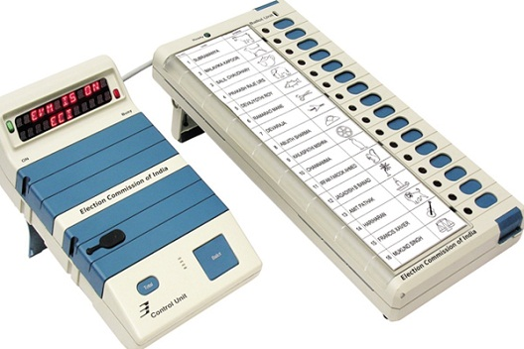
2. SECURED DESIGN FEATURES
Population
Real Time Clock for time and date stamping key press
No Radio Frequency transmission or reception possible- No wireless communication possible
One Time Programmable (OTP) chip
Dynamic Coding of Key Press
Standalone Machine
Notes:
EVMs are designed to be 100% secure. ECI EVMs are standalone machines and cannot be connected to any other device either through wire or wirelessly. A CU can be connected only to a BU. EVM has No radio frequency transmission capability, ruling out wireless connection through wifi, bluetooth, etc. The microcontroller chip on which the software is fused is one time programmable ruling out any possibility of re-programming. The transmission of signals from BU to CU is encrypted dynamically. This means everytime even same button is pressed in BU the signal is transmitted with a different encryption formula, ruling out any possibility of reverse engineering of software code. There is also another feature of date and time stamping of every key pressed. This helps in giving a complete audit of keys pressed.

Slide 12
3. SECURE DEVELOPMENT PROCESS
Software validation is carried out as per the System Requirement Specification (SRS), by an Independent Testing Group.
The software is designed/approved by TEC NEVER subcontracted.
Notes:
The software is designed or approved by TEC. Its development is never subcontracted.

Slide 13
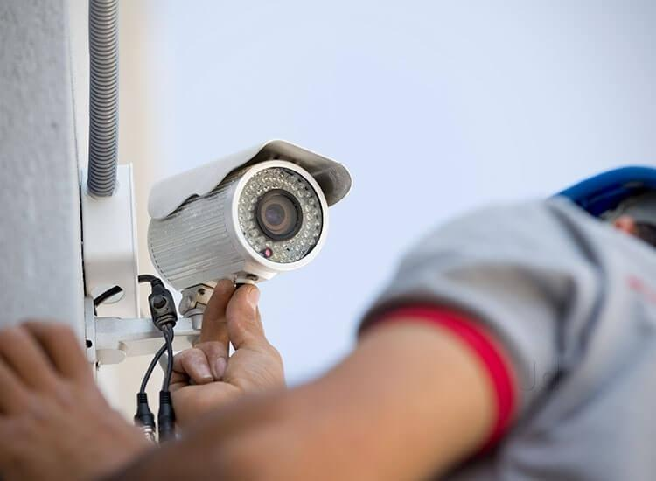
4. SECURE MANUFACTURING FACILITY
Monitored Entry and Exit
Regular frisking at gates and all important junctions
CCTV surveillance
Entry of electronic gadgets like mobile, Laptop, USBs restricted
Secure Factory Premises
Notes:
The EVM manufacturing at BEL and ECIL is done in factory premises which are fully secure. In addition the manufacturing process itself has well defined and calibrated process flow, data logging and alarm generation in case of deviations. STQC - A Third Party Agency appointed by the Commission independently does quality testing as per standards laid by TEC.

Slide 14
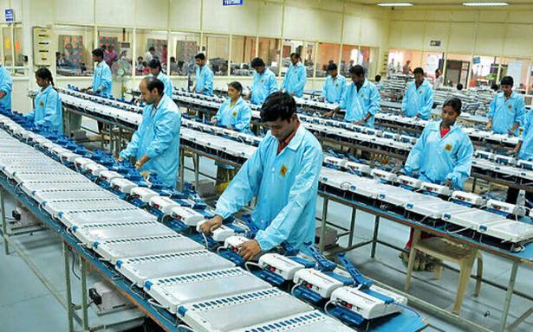
4. SECURE MANUFACTURING FACILITY
Physical Security -CCTV surveillance and movement control
Well defined and calibrated process flow of EVM manufacturing
3 Level Physical access to various stages / processes
Access Data and Process Data logging, alarm and alert generation during manufacturing
Third Party Testing by STQC as per Standards & Quality Process set by TEC
Notes:
The EVM manufacturing at BEL and ECIL is done in factory premises which are fully secure. In addition the manufacturing process itself has well defined and calibrated process flow, data logging and alarm generation in case of deviations. STQC - A Third Party Agency appointed by the Commission independently does quality testing as per standards laid by TEC.

Slide 15
EVOLUTION OF EVM MODELS
Evolution of technology
EVM Models
One Time Programmable Controller
Standalone Machine
Pre 2006: M1
2006-2010: M2
From 2013: M3
Notes:
While EVMs right from M1 models have been fully secure, Commission has introduced M2 and M3 models due to obsolescence of old technology. Additional security features have been added as per Technological advancements.

Slide 16
EVOLUTION OF EVM MODELS
Evolution of technology
EVM Models
Dynamic coding of every key press for communication from BU to CU
Real time clock
Time stamping of key presses
Pre 2006: M1
2006-2010: M2
From 2013: M3
Notes:
While EVMs right from M1 models have been fully secure, Commission has introduced M2 and M3 models due to obsolescence of old technology. All 3 models are standalone machines and with one time programmable microcontroiler

Slide 17
EVOLUTION OF EVM MODELS
Evolution of technology
EVM Models
Pre 2006: M1
Digital certificate based mutual authentication
Automated Self diagnostics
Battery life prediction
2006-2010: M2
From 2013: M3
Notes:
While EVMs right from M1 models have been fully secure, Commission has introduced M2 and M3 models due to obsolescence of old technology. Additional security features have been added as per Technological advancements.

Slide 18
ADMINISTRATIVE SAFEGUARDS
ADMINISTRATIVE SECURITY OF EVM

Slide 19
ADMINISTRATIVE SAFEGUARDs
Stakeholder Participation
Allocation & Movement
First Level Checking
Candidate Setting
Randomization
Mock Poll
Poll Day Checks
Poll Closure & Transportation
Storage & Security
Counting Day Protocol
Notes:
Let me now take you through the elaborate administrative safeguards that makes the EVM system absolutely impregnable

Slide 20
1. STAKEHOLDER PARTICIPATION
Active Participation of Political-Parties/Candidates in All Processes
Opening & Sealing of EVM Warehouses & Strong-rooms.
2
1
3
4
5
First Level Check (FLC) & Candidate Setting.
List of EVMs after first & second randomization
Conduct mock poll and receive mock poll results
Sign on Paper Seals on BUs and CUs after all important processes
Participation During FLC
Notes:
The first and the foremost safeguard is the active participation of political parties and candidates in the entire eco-system around EVMs, right from witnessing opening and sealing of warehouses and strongrooms, witnessing First Level Check & Candidate Setting, observing 2 stage randomisation, conducting mock polls and signing on various paper seals.

Slide 21
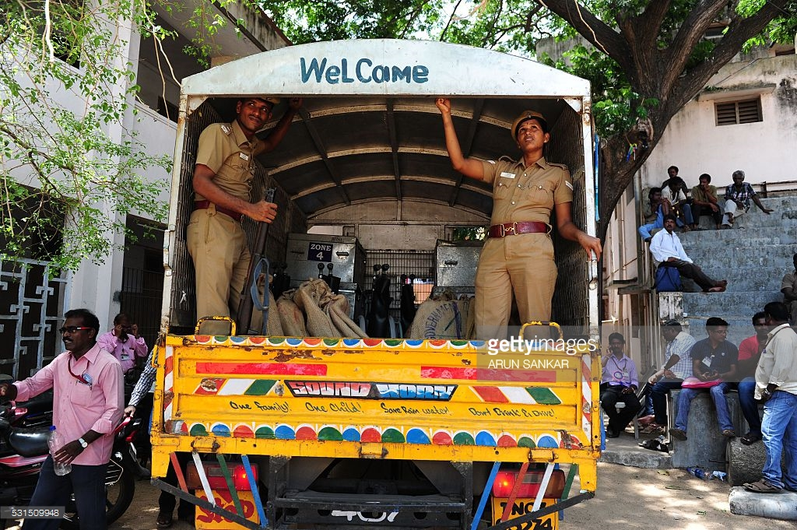
2. ALLOCATION & MOVEMENT
Secured Transportation
Planned Allocation
EVMs are allocated to poll going State by the Commission
Received by DEO who is personally responsible for secured storage
EVM Tracking Software for inventory management of all EVMs nationwide.
EVMs are always transported under 24/7 Police Escort –GPS tracking irrespective of the destination
Notes:
Around 6 months before the polls Commission allots EVMs to the poll going state either from BEL/ECIL or from other States. The EVMs then move under 24/7 police security and are received by the DEOs who are personally responsible for secured storage in their districts. The entire inventory management is done using EVM Tracking Software

Slide 22
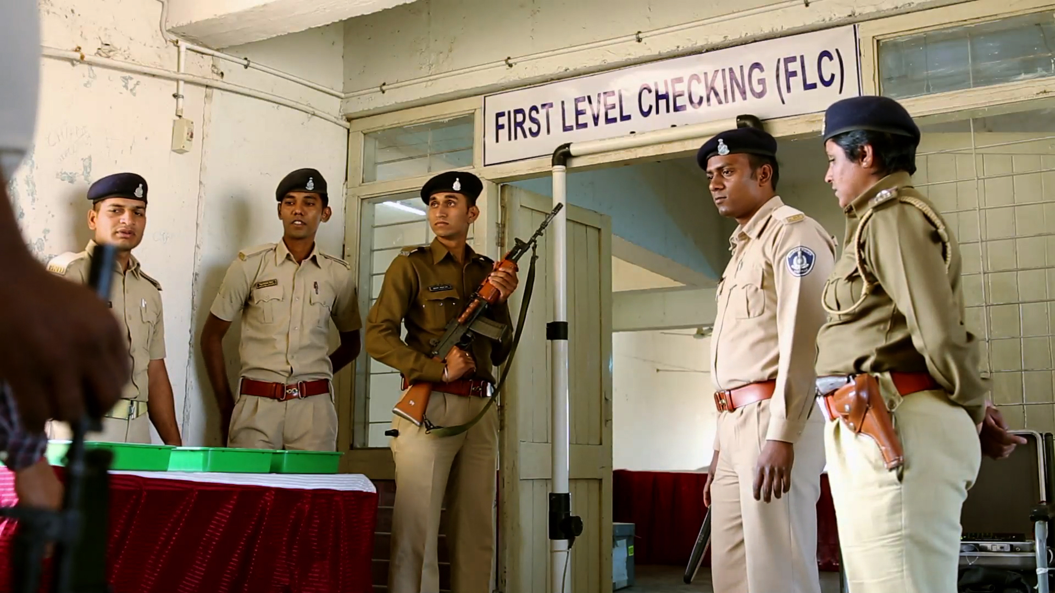
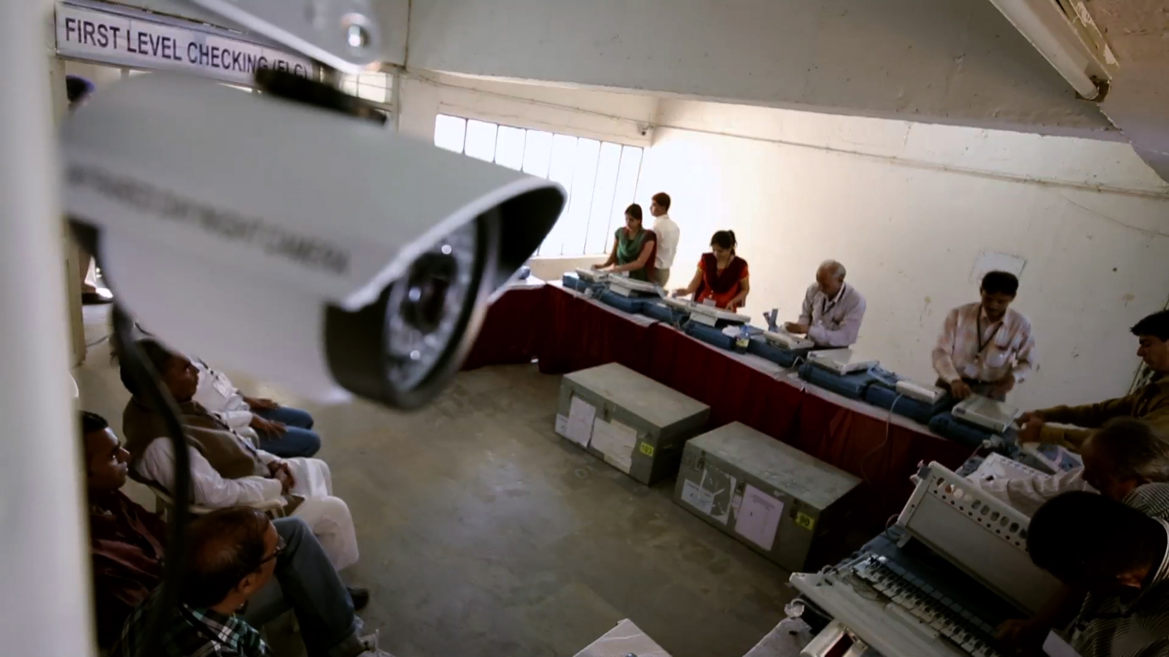
3. FIRST LEVEL CHECKING (FLC)
FLC in the presence of representatives of political parties.
Fully sanitized hall under videography and full security
Full functionality and behavioural check is done.
Defective EVMs are kept aside and not used in election
Notes:
Each EVM undergoes a first level check in a fully sanitized hall in the presence of political parties.

Slide 23
FLC PROCESS
Photocopies of record registers shared with political party representatives/candidates
Result printout and sequential voting printouts shared with representatives
Signing on seals by Engineers and representatives
Mock Poll on All EVMs
2
4
6
8
3
1
5
7
Mock poll with 1200 votes on randomly selected 1% EVMs, 1000 votes in 2% and 500 votes in another 2% EVMs
Complete physical check up (switches, cable, latches etc) & functional test
CU sealed after FLC using ‘Pink Paper Seal’
EVMs stored in Strong Room under 24X7 security
Notes:
FLC entails complete physical and functional check. Each EVM is then subjected to a mock poll. Additionally 5% randomly selected EVMs undergo a mock poll with atleast 1000 votes. Results of mock poll are printed and shared with representatives. CU is then sealed with Pink Paper Seal and EVMs moved to the Strong Room.
However, it is observed that Political Parties do not remain present for the entire FLC duration. We would urge all Parties to sensitise your representatives to witness the entire process.

Slide 24
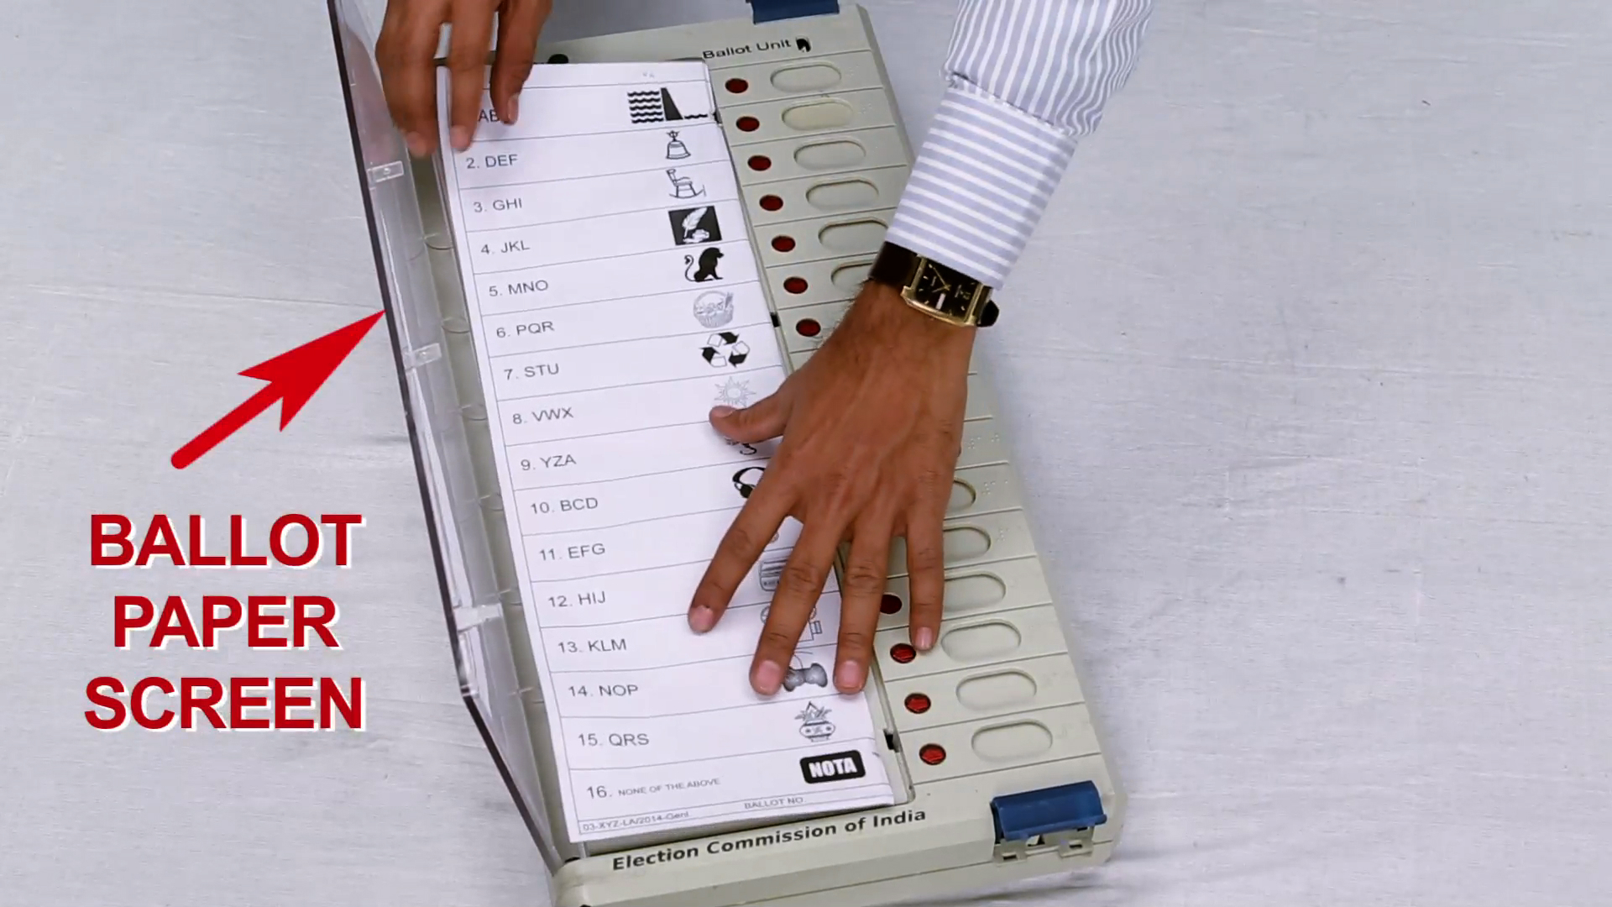
4. CANDIDATE SETTING
The Process
Insert ballot paper in the Ballot Unit & Set Number of Candidates
Seal Ballot Unit
Mock Poll on Every EVM + 1000 vote on 5% EVMs with VVPATs
Security Measures
1
Done after finalization of the names of contesting candidates
2
Fully sanitized hall under videography and full security.
3
Done in the presence of candidates or their agents.
Notes:
Yet another significant safeguard is the process of candidate setting which is done after the finalisation of contesting candidates. A ballot paper is inserted in the Ballot Unit which is then sealed with Pink Paper Seal. BU is sealed at this stage. Where VVPATs are used candidates symbols are loaded in each VVPAT at this stage. Once again every EVM is subjected to mock poll and 5% EVMs are randomly picked up for 1000 mock poll.
Here again we will urge all parties to ensure continuous and active participation during the entire process of Candidate Setting and conduct of Mock Poll

Slide 25
5. RANDOMIZATION
EVMs are Randomized twice using EVM Tracking Software (ETS).
Only FLC approved EVMs recorded in ETS get picked up for first randomisation
1st Randomization
2nd Randomization
- Done after FLC
- To allocate EVMs available in district, randomly, to a particular AC.
- In presence of representatives of political parties.
- List of AC-wise Randomized CU/BU and the training EVMs shared with political parties.
Notes:
EVMs undergo two stage randomisation using EVM Tracking Software, first while being allotted from district to ACs, and then from AC to Polling Stations. The list of allotted EVMs are shared with political parties or candidates.

Slide 26
5. RANDOMIZATION
EVMs are Randomized twice using EVM Tracking Software (ETS).
Only FLC approved EVMs recorded in ETS get picked up for first randomisation
1st Randomization
2nd Randomization
- Done just before ‘candidate setting’.
- To allocate EVMs available in an AC to specific polling stations.
- In presence of candidates/election agents and list shared.
Notes:
EVMs undergo two stage randomisation using EVM Tracking Software, first while being allotted from district to ACs, and then from AC to Polling Stations. The list of allotted EVMs are shared with political parties or candidates.

Slide 27
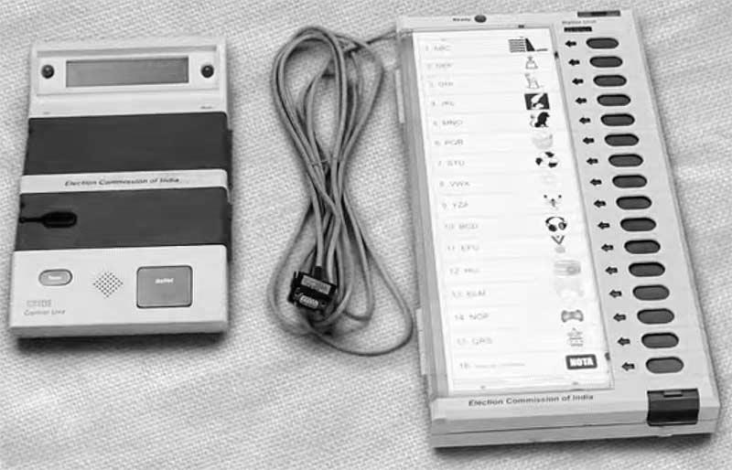
5. RANDOMIZATION
PS1
1st Randomization
2nd Randomization
District
AC 1
PS2
AC 2
PS(n)
AC (n)

Slide 28
RANDOMIZATION- THE FOUNDATION OF EVM SECURITY
Till first randomization, no one knows which EVM is going to which AC
Till finalization of nomination no one knows the sequence of names on the ballot paper
Hence, till candidate setting no one (not even RO/DEO/CEO/Commission) knows which button on which BU will be assigned to which candidate, making even an attempt to tamper absolutely futile.
Till 2nd Randomization, no one knows which EVM will go to which PS
Added to this, is the 3 stage Randomization of polling station officials.
Notes:
As you can appreciate, till first randomisation no-one can predict which EVM will go to which AC. In addition, no-one knows the sequence of names on the ballot paper till the finalisation of list of contesting candidates as the names are placed alphabetically first for National & State Parties, followed by other Recognised Parties, followed by independents. Hence till candidate setting no-one, not even RO or DEO or CEO or the Commission could know which button on which BU will be assigned to which candidate. Again till 2nd randomisation no one knows which EVM will go to which Polling Station.

Slide 29
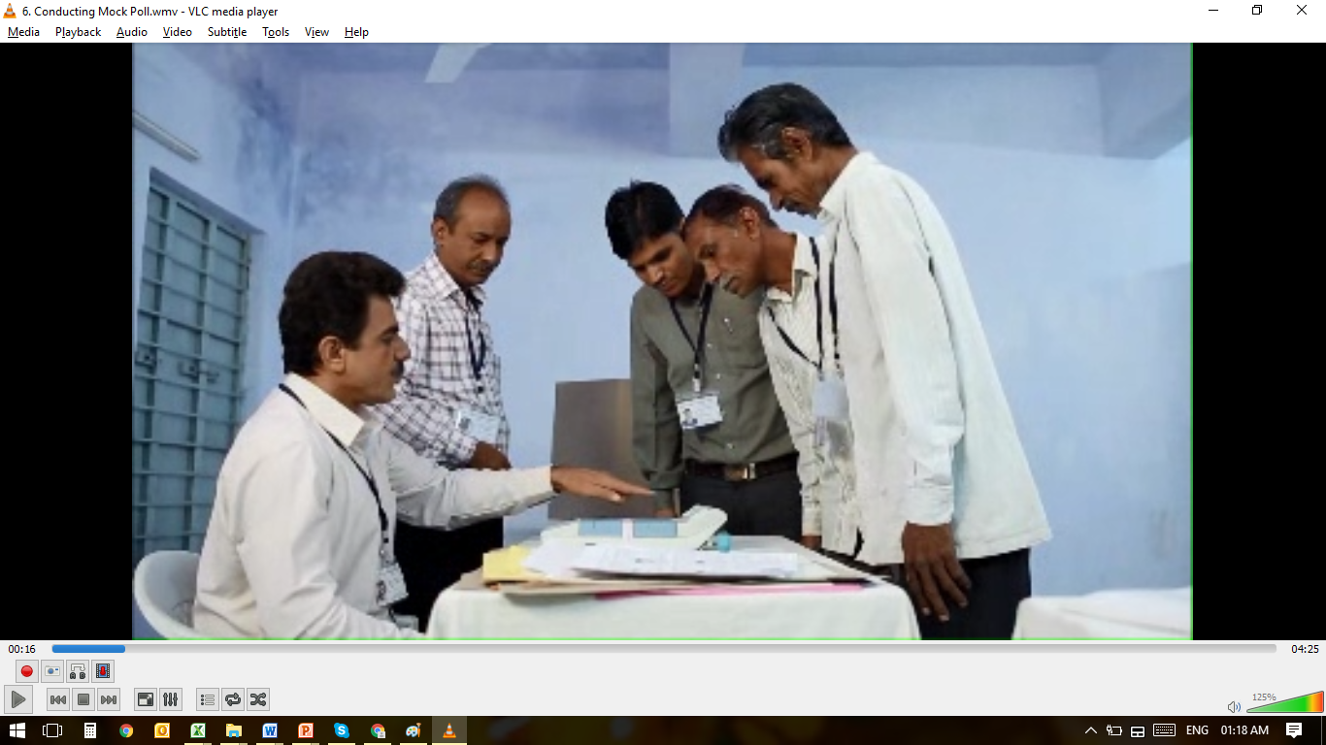
POLL DAY MOCK POLL
Before start of actual poll, Mock poll with at least 50 votes in the presence of candidates/their agents.
Mock poll data is erased and shown to the agents.
The Presiding Officer issues the Mock Poll Certificate with signature of the representatives of candidates.
Notes:
On the of the pole mock poll is conducted with at least 50 votes in the presense of the polling agents

Slide 30
7. POLL DAY CHECKS
Polling Agents
CAPF, Micro-Observers, Webcasting/CCTV
Frequent visits by Sector Officers and other senior officers, including Observers
2 hourly reporting of votes polled
Media
Notes:
Multiple measures are put in place on the poll day to further strengthen the poll process.

Slide 31
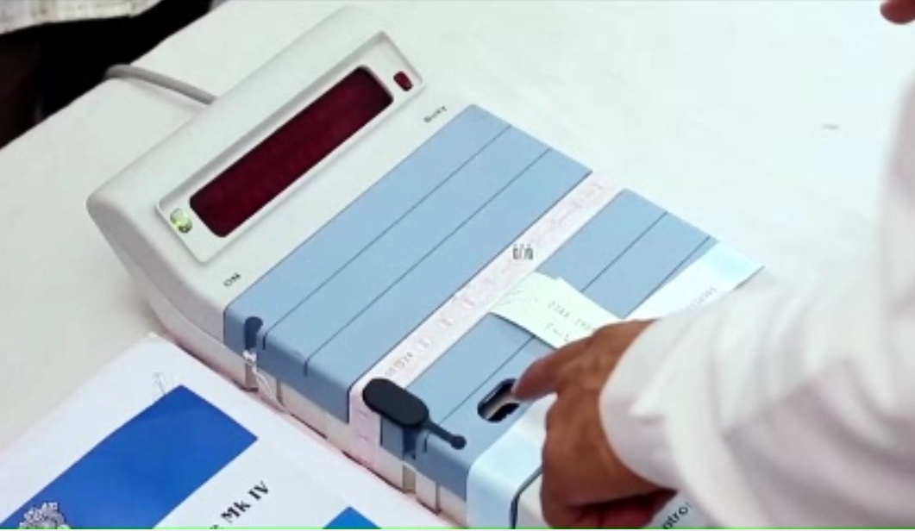
8. POLL CLOSURE & TRANSPORTATION
Poll Closed on EVM by pressing CLOSE button on CU
Notes:
After the poll any further voting on EVM is disabled by pressing CLOSE button on CU. EVMs are then sealed and transported to the strong rooms under armed escort. Candidates agents are also allowed to follow the EVM carrying vehicles. In addition arrangements are made for candidates or their agents to watch strong room 24/7 till the counting day.

Slide 32
8. POLL CLOSURE & TRANSPORTATION
EVMs sealed in carrying cases and polling agents sign on them.
Notes:
After the poll any further voting on EVM is disabled by pressing CLOSE button on CU. EVMs are then sealed and transported to the strong rooms under armed escort. Candidates agents are also allowed to follow the EVM carrying vehicles. In addition arrangements are made for candidates or their agents to watch strong room 24/7 till the counting day.

Slide 33
8. POLL CLOSURE & TRANSPORTATION
The machines are transported back to the reception centres under proper armed escort. Candidates’ representatives are allowed to follow them
Notes:
After the poll any further voting on EVM is disabled by pressing CLOSE button on CU. EVMs are then sealed and transported to the strong rooms under armed escort. Candidates agents are also allowed to follow the EVM carrying vehicles. In addition arrangements are made for candidates or their agents to watch strong room 24/7 till the counting day.

Slide 34
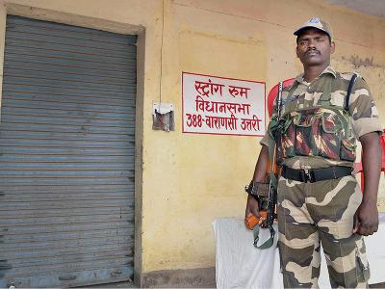
8. POLL CLOSURE & TRANSPORTATION
EVMs are kept in strong room, sealed in the presence of the Candidates and Observer
Facilitation for Candidates to watch the Strong Room 24/7
Starting from FLC of EVMs to Counting of votes, EVMs are kept in Strong-room with full 24/7 security
Notes:
After the poll any further voting on EVM is disabled by pressing CLOSE button on CU. EVMs are then sealed and transported to the strong rooms under armed escort. Candidates agents are also allowed to follow the EVM carrying vehicles. In addition arrangements are made for candidates or their agents to watch strong room 24/7 till the counting day.

Slide 35
9. STORAGE & SECURITY
Non- Election Period
Election Period
Post- Election Period
EVM storage warehouse with only one entry point.
Other doors or windows sealed using brick-masonry or concrete.
Entry secured by a double lock system.
The keys held jointly by two separate officers, nominated by the DEO.
24X7 security arrangement.
Annual Physical Verification of entire stock by ECI and tracked through ETS
Notes:
Elaborate security protocol, both during election as well as non-election period, clubbed with the transparency protocol mandating written intimation to political parties and candidates everytime the warehouses are opened ensure that no-one can access the EVMs at any time. This security protocol is strengthened multifold while storing polled EVMs with CAPF, CCTV & Candidates Watch.
In addition ECI undertakes annual physical verification of entire EVM stock across the country.
However, All Political parties are also requested to kindly keep an eye on EVM warehouses even during non-election period

Slide 36
9. STORAGE & SECURITY
Non- Election Period
Election Period
Post- Election Period
EVMs are stored in a strong room in the presence of representatives of Political Parties, under videography.
Training EVMs are kept in a separate strong room
After Candidate Setting EVMs are again stored in Strong Room
EVMs are taken out only on the day of dispersal of polling parties.
Candidates or their agents and ECI Observers are present through out this process and minutely monitor the same.
Notes:
Elaborate security protocol, both during election as well as non-election period, clubbed with the transparency protocol mandating written intimation to political parties and candidates everytime the warehouses are opened ensure that no-one can access the EVMs at any time. This security protocol is strengthened multifold while storing polled EVMs with CAPF, CCTV & Candidates Watch.
In addition ECI undertakes annual physical verification of entire EVM stock across the country.
However, All Political parties are also requested to kindly keep an eye on EVM warehouses even during non-election period

Slide 37
9. STORAGE & SECURITY
Non- Election Period
Election Period
Poll-Counting Period
EVMs are escorted back to the strong room post poll and remains under double lock
Candidates allowed to put their own locks
Two cordoned round the clock security arrangements for the strong rooms having polled EVMs
The CPF secures the innermost perimeter immediately outside the strong room and the State Armed Police secures the outer perimeter.
24/7 security arrangement for unused EVMs also.
Notes:
Elaborate security protocol, both during election as well as non-election period, clubbed with the transparency protocol mandating written intimation to political parties and candidates everytime the warehouses are opened ensure that no-one can access the EVMs at any time. This security protocol is strengthened multifold while storing polled EVMs with CAPF, CCTV & Candidates Watch.
In addition ECI undertakes annual physical verification of entire EVM stock across the country.
However, All Political parties are also requested to kindly keep an eye on EVM warehouses even during non-election period

Slide 38
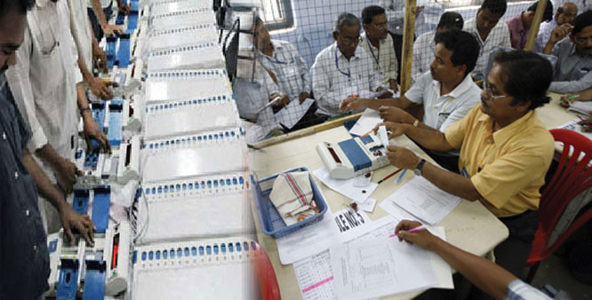
10. COUNTING DAY PROTOCOL
On the day of counting, strong room opened in the presence of Candidates, RO and Observer under videography.
Round-wise CUs are brought to the counting tables.
Unique ID number of the CU & the signed seals are verified and shown to the polling agents.
EVMs are stored back in Strong Room in the presence of candidates/their representatives.
Notes:
On the counting day CUs are moved under cctv and its seals verified by the polling agents before taking out results. Post counting EVMs are moved back to strong rooms. However where VVPATs are used, paper slips are transferred to a black envelope which is sealed and kept in a separate plastic box and securely stored along with EVMs in Strong Room. VVPATs are now free for reuse.

Slide 39
ELECTION PETITION PERIOD
REGISTERING COMPLAINT

Slide 40
ELECTION PETITION PERIOD
Election Petitions can be filed within 45 days of result declaration
EVMs & VVPATs under EP are moved to a separate Strong Room with the approval of the High Court.
Remaining EVMs & VVPATs are now free for re-use.
EVMs (BU+CU) and VVPATs remain under sealed conditions till EP position is ascertained.

Slide 41
DOUBTS CAST- EXPLAINED!
CLARIFICATION OF ALL DOUBTS

Slide 42
DOUBTS CAST ON EVM
Hacked EVM
Vote Stuffing after Poll Closure
Remotely Altered Control Unit Display
Memory Manipulation
Replaced Micro-controller or Memory chips
Altered software code

Slide 43
HACKED EVM
Hacking’ is unauthorised access to or control over computer network security systems for some illicit purpose
In the case of ECI EVMs, the word ‘Hacking’ is not applicable for following reasons:
The EVM is a stand alone machine and is not connected to any network through wire or wirelessly
The SW programme in the OTP Microcontroller can neither be read nor modified
Notes:
We would urge that the word ‘hacking’ is not used by anyone

Slide 44
REMOTELY ALTERED CU DISPLAY THROUGH WIRELESS COMMUNICATION
It is alleged this can be done by either replacing the original display module with another display fitted with a wireless device or inserting an extra circuit board which can communicate with an external unit via a wireless device and tamper the result by controlling the CU display used for declaring the result
Such a modification would require unfettered access to the EVM after FLC – Ruled out.
Notes:
Another aspersion is that the result display can be altered remotely through bluetooth, wifi, etc.

Slide 45
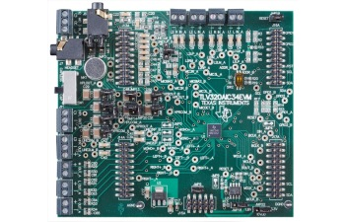
MEMORY MANIPULATION
It is alleged that voting data can be altered by clipping a Memory Manipulator IC to the memory chip where Vote data is stored. This would need,
Full and free access to CUs after the Polling is over- Ruled Out !!
Breaking the seals and locks of the strong room in the presence of two layers of security plus the representatives of the candidates camping near the strong room- Ruled Out !!
Notes:
Yet another allegation says that

Slide 46
REPLACEMENT OF MICRO-CONTROLLER/MEMORY CHIP or MOTHERBOARD BEFORE POLL/COUNTING
Administrative Safeguards
Chip replacement would require access to EVM Warehouses – Ruled Out
Any chip replacement before FLC will get caught during FLC
Chip Replacement after FLC would require access to Strong Rooms and breaking of EVM Pink Paper seals– Ruled Out
Technical Security
BUs and CUs communicate only amongst themselves and go into error mode if connected to any other machine. Thus, any modified EVM (with microcontroller /memory changed) would not be usable even if someone is able to hypothetically bypass security arrangements and modify EVM
Notes:
A few naysayers allege that EVM can be tampered by replacing the micro-controller or the memory OR EVEN THE FULL MOTHERBOARD. However both administrative safeguards as well as tech security rule that out.

Slide 47
TAMPERED SOURCE CODE “TROJAN”
It is alleged that Trojan can be introduced in following manner
by reprogramming the chip, or
by the chip manufacturer during fusing of the software.
Re-programming Ruled Out as these are OTP chips.
Code tampering by the chip manufacturer Ruled Out as it will get caught during the code integrity check.

Slide 48
VOTE STUFFING AFTER POLL CLOSURE
Administrative safeguards
Poll closed by pressing the “CLOSE” button on the CU after last vote, Representatives of candidates who are present signs on the seals
EVM seals checked on counting day
What if seals broken and votes stuffed while transporting?
EVM does not accept any votes after CLOSE button pressed in CU
What if CLOSE button not properly pressed and Votes Stuffed while transporting?
Poll Closure time recorded in the PO’s diary and any votes polled in the EVM after this time can be identified due to time stamping of key presses

Slide 49
ASPERSIONS VS CONFIDENCE
SINCE 11TH MARCH

Slide 50
Sl. No. | Aspersions/ Allegations | Fact Check/ Reality
 | Unauthorized Access to EVMs | ECI-EVMs inaccessible. Kept in warehouses/ strong rooms under high physical security. Each machine has a unique number. Stolen EVMs cannot re-enter.
2. | Pressing multiple buttons leads to multiple votes | The button pressed at first, followed by a long beep sound, is counted as one vote. Next vote can be cast only after the Presiding Officer presses the ballot button in the Control Unit. No chances of casting multiple votes.
3. | Tampering the Hardware | First Level Check of each and every EVM is done by engineers of ECIL & BEL in presence of political parties’ representatives before elections.
4. | The Software Chip | One Time Programmable Chip. No extra port or chances of any network connectivity in ECI-EVMs.
5. | Dishonest Polls, after Honest Mock Polls | At least 1000 votes are cast by political parties’ representatives in 5% of randomly chosen EVMs from warehouses. Mock polls are also done in presence of stakeholders.
Notes:
Commission has received several complaints casting aspersions, all of which are unfounded as already explained.

Slide 51
Sl. No. | Aspersions/ Allegations | Fact Check/ Reality
6. | Low Tech Seals | Security seals from Nasik Printing Press are used. Sealing of EVMs and strong rooms/ warehouses are done in presence of political parties’ representatives.
7. | Bhind, Madhya Pradesh, 2017: All buttons allegedly voted BJP | Only during the demo on 31st March, 4 votes were cast and all 4 correctly went to respective candidates and printed respective slips. However, the VVPAT was used in UP elections 2017 and the memory was not rebooted before being used for the demonstration.
8. | The Dholpur Incident: All buttons allegedly voted BJP | Two EVMs were found defective, but none gave any wrong results.

Slide 52
BHIND FINDINGS
Commission’s enquiry found 4 buttons of BU pressed in the following order and VVPAT printed corresponding slips
Button no | Symbol | Name of Candidate
03 | Handpump | Raju Pal
04 | Lotus | SatyaDev Oanchori
03 | Handpump | Raju Pal
01 | Hand | Ambuj Shukla
It is pertinent to mention here that is it completely false to say that the multiple times slips of lotus were printed during the demo on 31st March as alleged
Notes:
As can be seen, the 4 buttons pressed and 4 slips printed clearly shows that there was nothing wrong with EVMs or VVPAT. The allegation that VVPAT printed the same symbol irrespective of the button pressed is completely false. However, the SOP of conducting FLC even before using any EVM for training or demonstration was missed at Bhind and as a result the previously loaded symbols in VVPAT were not erased before the demo. As a result the VVPAT printed the symbols and names corresponding to Kanpur AC.

Slide 53
From 11 March 2017 to 12 May 2017
120 Petitions Received
41 alleging wrong results
17 Related to SEC
Evidence Sought from 24
Reply by 3
Evidence by none
Notes:
Since 11 Mar 120 petitions have been received by the Commission. 41 of these alleged wrong results. 17 of these relate to SECs. We had sought evidence from remaining 24 but while 3 have responded, none have given any evidence of tampering.

Slide 54
ALL POLITICAL PARTIES MEETING HELD ON 12.05.2017
07 National and 35 State Parties participated.
Hon’ble CEC clarified the details about Bhind incident and Dholpur Bye-elections and reiterated that baseless allegations and incorrect aspersions were levelled and there was no case of any biased/manipulated vote recording.
Wide range of technical, administrative protocol and procedural safeguards were explained that fortify the EVMs and VVPATs ecosystem against any sort of manipulation or tampering.
Informed the political representatives that the Commission would hold EVM challenge.
Assurance of 100% coverage of VVPATs in all future election to the Parliament and State Assembly Elections.

Slide 55
EVM-CHALLENGE HELD ON 03.06.2017
Commission held a Press Conference on 20th May, 2017 to announce EVM Challenge.
Invitation was sent to all National and State Recognized Political Parties to participate in the EVM Challenge from 3rd June, 2017 onwards.
Only two political parties, namely, Nationalist Congress Party (NCP) and Communist Party of India (Marxist) elicited interest.
Both parties reported to the Challenge Venue on 3rd June, 2017. However, they did not wish to participate in the Challenge but only expressed their desire in understanding the EVM process.
They interacted extensively with the Technical Expert Committee of the Commission to clear their doubts.

Slide 56
PROTOCOL FOLLOWED ON DEFECTIVE EVMs

Slide 57
DEFECTIVE EVM PROTOCOL
Defective EVMs
Includes EVMs that fail to function due to any mechanical, structural or physical defect like faulty switches, broken button, faulty connections etc. However, these do not give Wrong Result.
EVMs are checked for defects during FLC, candidate setting, before start of poll and during poll.
FLC-rejected EVMs are sent to factory for repair within 7 days of completion of FLC
Serial Numbers and defects of these EVMs are noted and EVMs are sent to the manufacturers for analysis and repair.
Manufacturers follow same security protocols during repair as they do for manufacturing new EVMs.
Notes:
All EVMs found defective are sent to manufacturers for analysis and repair. Manufacturers follow same security protocols during repair as they do for manufacturing new EVMs.

Slide 58
INTERNATIONAL EXPERIENCE
INDIAN Vs Foreign EVMs

Slide 59
ECI EVM | Foreign EVM
Standalone | Mostly networked
Manufactured in Premium PSUs | Manufactured entirely by private entities
Verified and certified by an independent Technical Experts Committee | No such robust and independent certification/ checks
Data is stored internally and not transferrable by any device | Voting data recorded in the DRM is transferred by means of CD, etc
Full end to end security protocol and administrative safeguards for the use, storage, transportation and tracking | No such protocols, e.g. in Ireland
Administrative and physical security as per legal framework across the country. | No such legal framework, e.g. in Netherlands
Voter verifiability and auditability of every vote cast | Lack of such facility in the NEDAP machines- un-Constitutional by German Supreme Court as lacked public examinability
Notes:
In the notes we have clearly spelt out how ECI EVMs are far superior to any EVMs worldwide. While most EVMs used in foreign countries are internet connected only a few country like Germany, Netherlands Ireland, Brazil, Namibia etc. used standalone EVMs. However Germany , Netherland and Ireland stopped using EVMs as these were privately manufactured and they had no independent certification system unlike a very robust verification and certification system through independent TEC in case of ECI EVMS. Also voting data in these NEDAP EVMs was transferred using CDs, unlike our EVMs where it is stored internally. Also these countries lack full end to end administrative safeguards as well as legal framework. Finally their EVMs also lack auditability

Slide 60
PAST JUDGEMENTS
INDIAN Vs Foreign EVMs

Slide 61
JUDGEMENT SUMMARY
Madras High Court 2001
“There is also no question of introducing any virus or bugs for the reason that the EVMs cannot be compared to personal computers.”
Karnataka High Court 1999
‘This invention is undoubtedly a great achievement in the electronic and computer technology and a national pride’.

Slide 62
JUDGEMENT SUMMARY
Kerala High Court 2002
In one EP the High Court recorded its appreciation on the efficiency of the mechanism of detecting votes cast by impersonators. Upheld by the Hon’ble Supreme Court in 2003.

Slide 63
VOTER VERIFIABLE PAPER AUDIT TRAIL (VVPAT)

Slide 64
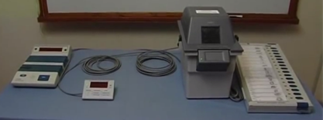
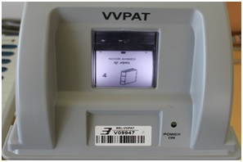
VVPAT
VVPAT- allows the voters to verify that their votes are cast as intended.

Slide 65
VVPAT
Voter Verifiable Paper Audit Trail is an independent system, attached with the Electronic Voting Machines, that allows the voters to verify that their votes are cast as intended.
When a vote is cast, the elector shall be able to view through the transparent window of the VVPAT, the printed paper slip showing the serial no, name and the symbol of the candidate of his choice.
The slip remains exposed through the window for 7 seconds, after which it automatically gets cut and falls in the sealed drop box of the VVPAT.
Since 2013 to 12 May 2017, VVPATs were used in selected constituencies in every Legislative and Parliamentary election.
Since May 2017, VVPATs are being used at 100% polling stations in every General/Bye election to Lok Sabha and State Legislative Assembly.
Notes:
6565

Slide 66
VVPAT Complaint – Rule 49MA
In case a voter complains of wrong printing by VVPAT:
He will report to Presiding Officer
Presiding Officer will take a declaration explaining that if found false he can be penalized.
PO will then record in 17A and permit him to cast a ‘test vote’ in presence of PO and Polling Agents
If found false PO will record in 17A and 17C so that the test vote is not counted
If found true then PO will stop poll and report to RO

Slide 67
VVPAT COUNTING ON FLC & COMMISSIONING
In FLC of VVPATs, mock poll with 6 votes against each of 16 candidate buttons are done followed by observation of result and tally of electronic count and printed paper slips of VVPATs for each VVPAT, in the presence of representatives of recognized National and State Political Parties.
In commissioning of EVMs and VVPATs, mock poll with 1000 votes are done in randomly selected 5% of EVMs and VVPATs, followed by observation of result and tally of electronic count and printed paper slips of VVPATs, in the presence of candidates/their representatives.

Slide 68
VVPAT RECOUNTING PROCESS
Counting of votes according to Rule 56C of Conduct of Election Rules,1961
After announcement of result any candidate/ his agent may apply in writing to the RO for counting of paper slips of VVPAT
The RO shall pass a speaking order on whether the counting will be done or not after considering the following:
- Whether total number of votes polled in that polling station is more or less than
the margin of votes between the winning candidate and the applicant
- Whether EVM met with any defect and was replaced at that polling station
during poll
- Whether there was any complaint about the VVPAT not printing the paper slips
or complaint under rule 49MA by any voter in that polling station during the poll
VVPATS were used in all 5 states but in Goa alone recount requested and permitted by RO in all 4 requests
Count exactly matched in all the 4 recounts done

Slide 69
MANDATORY VVPAT SLIPs COUNTING
Mandatory verification of VVPAT printed slips of randomly selected 01 polling station of
Each Assembly Constituency in Assembly elections
Each Assembly Segment of Parliamentary Constituency in Parliamentary elections.
In case of non-display of result on Control Unit, printed paper slips of the respective VVPAT are counted.

Slide 70
PRESENT STATUS
In the light of technical security features and administrative safeguards, Commission has full confidence on its EVM system
Commission is committed to deploying 100% VVPATs in all future elections
Orders placed to supply 16.15 lakh VVPATs, 13.95 lakh BUs & 9.30 lakh CUs by Sep 2018
Delivery started and expected to complete by Sep 2018
Notes:
To conclude, Commission reiterates it absolute confidence on its EVM system and is committed to deploy 100% VVPATs in all ensuing elections for which procurement orders have already been placed. Commission has received certain representations on VVPAT recount rules and is open for your suggestions, if any.

Slide 71
THANK YOU

